Slide 1
Deneb and Vega-Lite: The Secret Weapon for Custom Power BI Visuals
Krystsina Kremianeuskaya

Slide 2

About me
Power BI consultant with 12+ years of experience in providing innovative BI solutions for a wide range of clients.
Extensive knowledge of Power BI, including advanced reporting and data modelling.
kristinavodich@gmail.com

Slide 3
Agenda
Why Deneb visual
Demo 1. Quick custom visual
Demo 2. Timeline visual
Demo 3. Bullet chart with trellis
Can ChatGPT make it even easier?

Slide 4
Why Deneb visual

Slide 5
Before Deneb
Custom visuals are limited and bring additional cost
Charticulator not supported by Microsoft anymore
D3.js visuals are not certified hence cannot be exported to PDF
Not every developer can write JS code, learning requires a lot of time and efforts
Notes:
Customizing visuals in Power BI has always been a challenge. As a developer who started working with Power BI after Qlik View, I’ve needed some time to adapt and accept the fact that some customizations are just not possible. I’ve played around with custom visuals from library, faced the performance and licensing limitations. I’ve tried my best with Charticulator and still was not able to achieve what I’ve expected. For some time, I’ve been convinced that there’s no better way than stick to the basic visuals and simplify the report as much as possible.
I also should add that throughout my whole experience I’ve been focused on working with data, so I don’t have any serious programming background and learning any JS libraries like D3 was never a goal for me.
D3.js, for one of my projects I’ve been preparing some C-level reports and was looking for some state-of-art looking one-pager design approaches. As you can imagine - this was hard to achieve using only bar and line charts. Other visuals were not that useful. We’ve added some card- combination, were able to develop interesting visualizations (as the heatmap that you can see on the slied), but it was still not enough. And we’ve started to utilize D3.Js visuals. They’ve helped us a lot with brightening the landscape of our reports, but still had some limitations (slide text)
The last point was the most crucial in our case - the C-level person, the customer of this report was quite serious on the idea to export the report to PDF.

Slide 6
Deneb
Easy to kick-off the development
Easy to learn, modify and support
Great library with examples, possibility to start the development by using the template from the example
Different interaction options, configurable tooltips
Certified visual, export to PDF supported

Slide 7
Quick custom visual

Slide 8
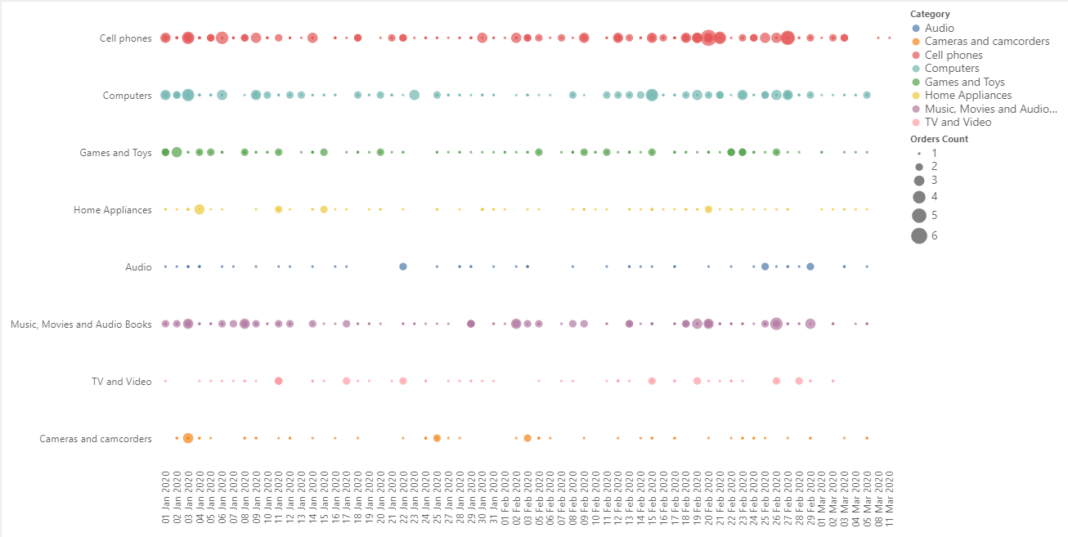
Challenges:
Simple chart that is hard to achieve with standard Power BI capabilities
Links:
https://vega.github.io/vega-lite/examples/
https://vega.github.io/vega-lite/docs/

Slide 9
Quick custom visual

Slide 10
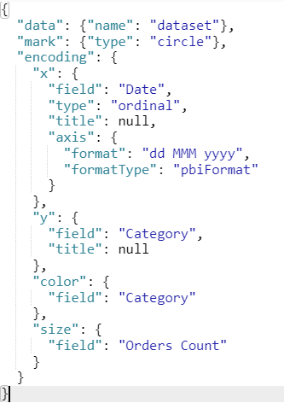
Data source
Mark type. Can be bar, line, circle, text
Define X-axis:
Source field
Type (nominal, ordinal,temporal, …)
Additional configuration
Define Y-axis
Mark properties

Slide 11
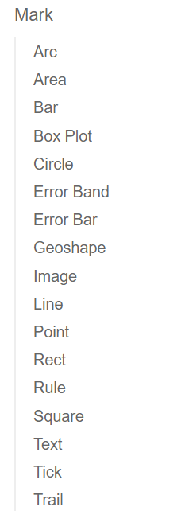
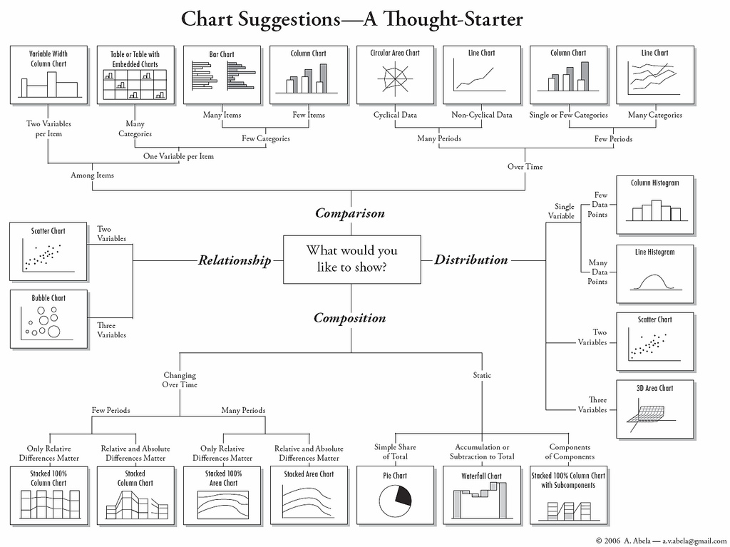

Slide 12
Timeline visual

Slide 13
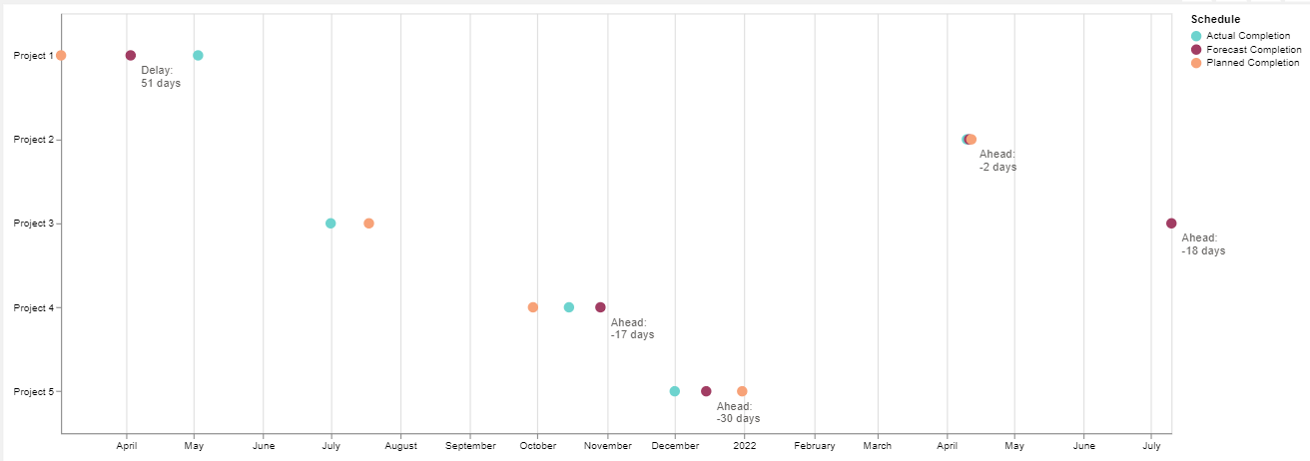
Challenges:
Interaction
Tooltips
Conditional label

Slide 14
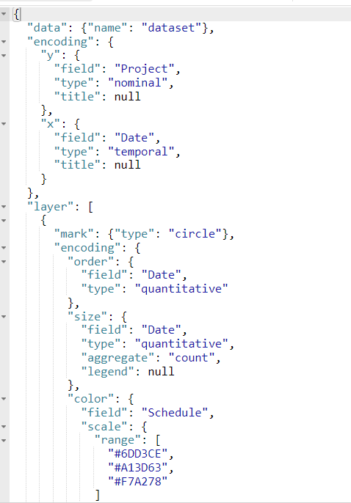
Step 1. Create a visual
Defining data source, X and Y axes similar to the previous step
Changing code structure to prepare it for mark layering

Slide 15
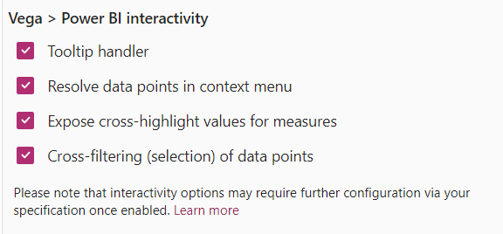
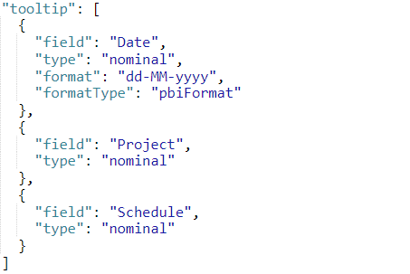
Step 2. Enable interactivity
Enabling interactivity options
Adding tooltip configuration to the mark properties

Slide 16
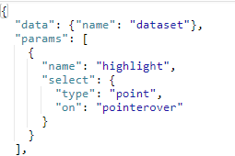
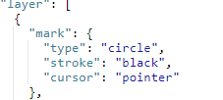
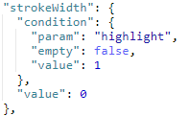
Step 2. Enable interactivity
Adding params section
Enabling Pointer cursor
Conditional stroke width

Slide 17
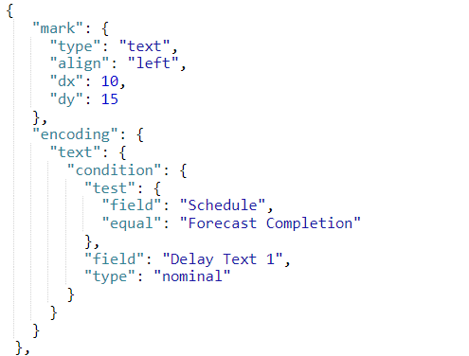
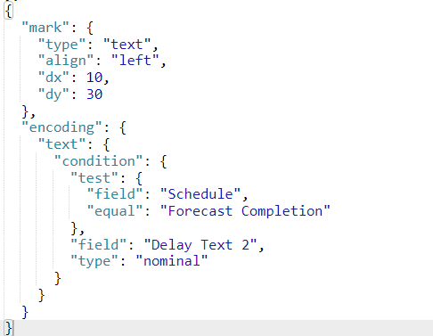
Step 3. Adding a text mark with a conditional label
Row 1
Row 2

Slide 18
Bullet chart with trellis

Slide 19
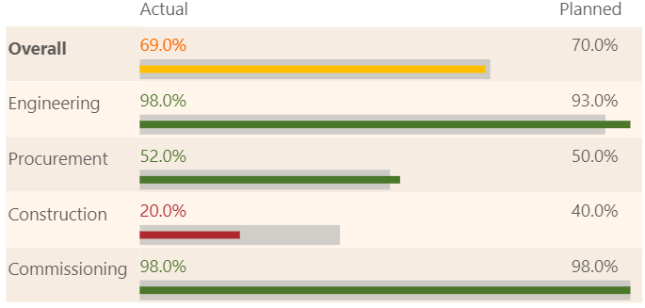
Approach: Decomposition and layering
Adding Transform section to optimize the code

Slide 20
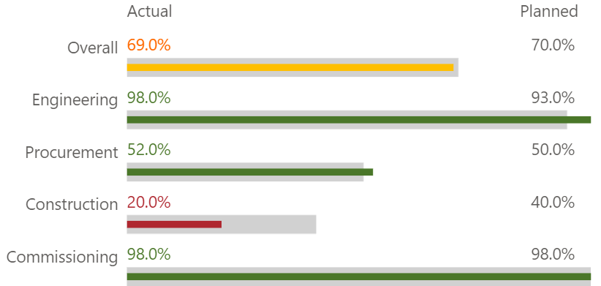
Part 1 – Creating a partly similar chart
Questions:
Which marks do we have here?
Which types of marks do we need to use?
How to enable Actual and Planned headers?

Slide 21
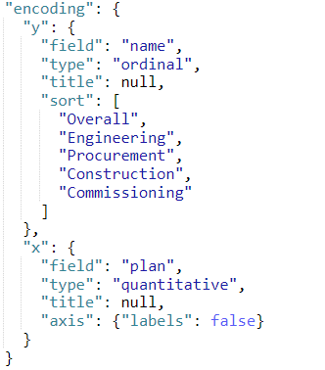
Starting with axes
Adding custom sorting
Disabling the titles
Disabling the data labels for X-axis

Slide 22
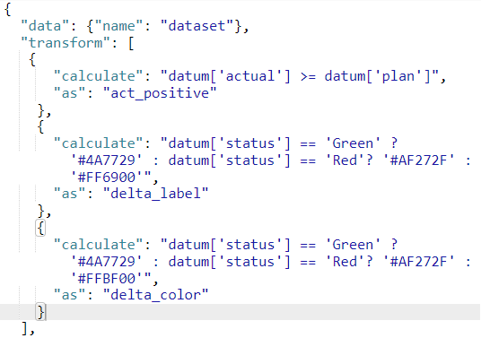
Adding a transform section
Logical result
„As” represents the name
Label color for the Actual %
Label color for the Actual bar color

Slide 23
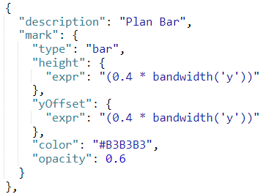
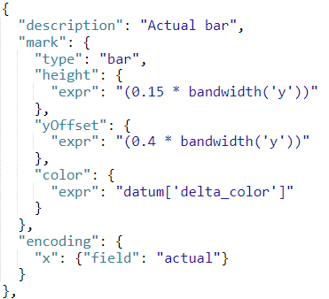
Defining bars. Spot the differences

Slide 24
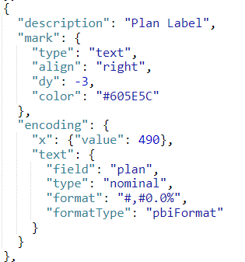
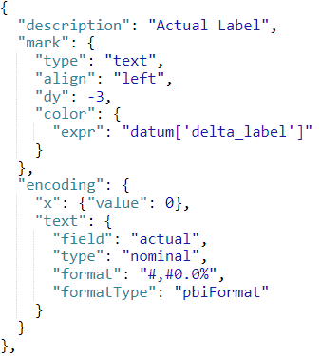
Defining labels

Slide 25
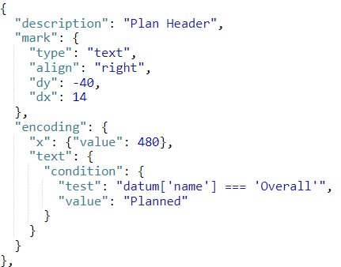
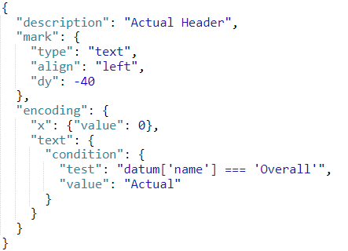
Adding headers

Slide 26
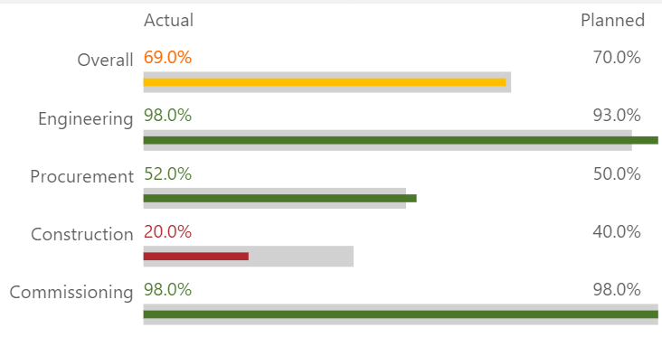
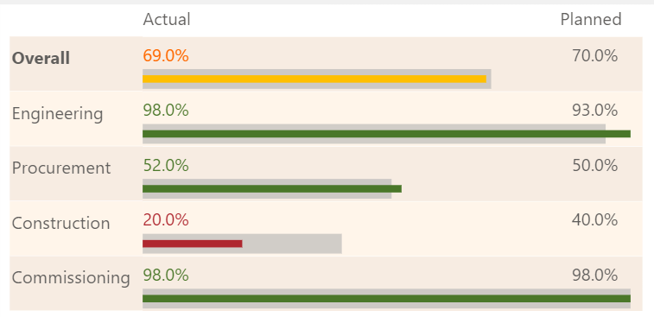
Step 2. Customization

Slide 27
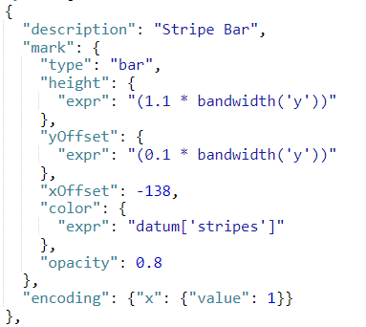
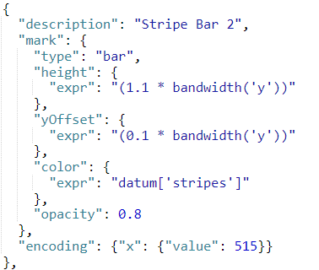
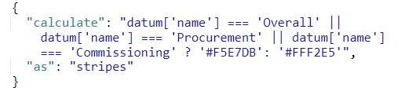
Striped background
Stripe Bar
Stripe Bar 2

Slide 28
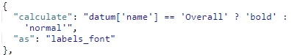
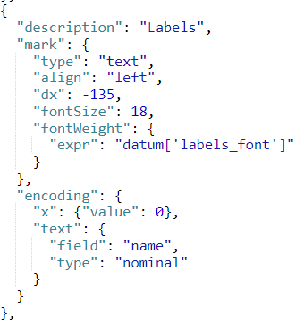
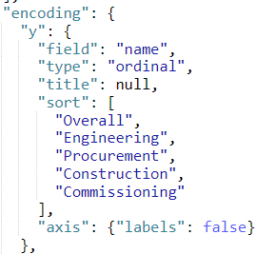
Add data labels over the bars

Slide 29
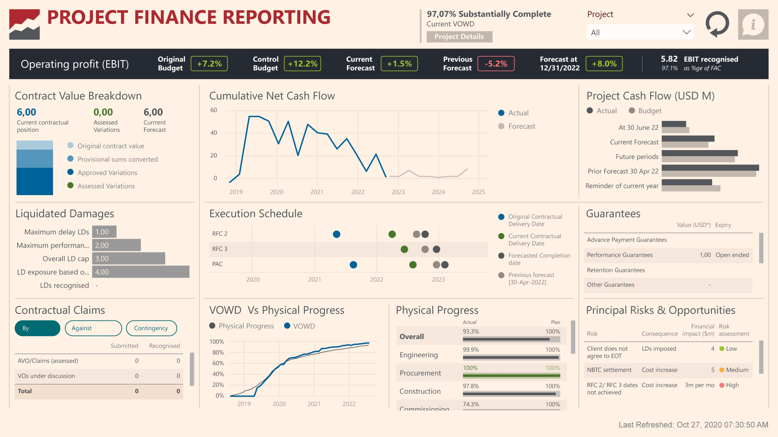
Result

Slide 30
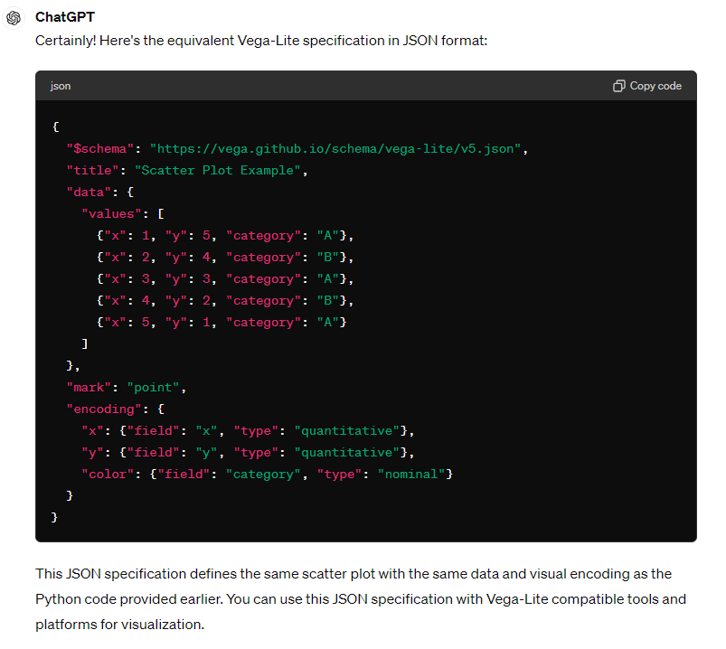
Can ChatGPT make it even easier
ChatGPT 3.5 does not know Deneb visual, but certainly can help you to create visuals with Vega-lite library

